Slide 1
Control systems project
MUHAMMAD SADEEQ (21PWCSE2028)

Slide 2

STATE SPACE EQUATION
A= $\begin{matrix}4 & 0 \\ 0 & 1\end{matrix}$​ B = $\begin{matrix}0.4 \\ 0.3\end{matrix}$
C= [1​ 0​] D = 0

Slide 3
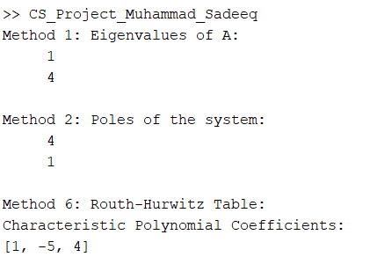
STABILITY OF SYSTEM
Method 1: Eigenvalues of A
Method 2: Poles of the system
Method 3: Pole-Zero Map
Method 4: Root Locus
Method 5: Step Response
Method 6: Routh-Hurwitz Table

Slide 4
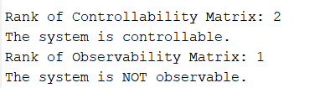
Controllability & Observability
Controllability Test
Observability Test

Slide 5
Pid controller design

